Slide 1
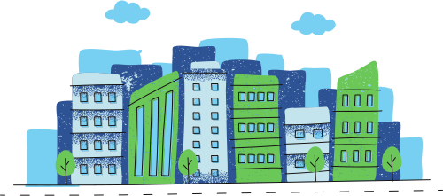
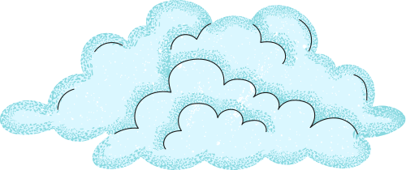
What are hydrological and atmospheric hazards?
Hydrological hazards are linked to the movement, distribution, and behaviour of water on Earth. For example, floods, storm surges, landslides and avalanches.
They are driven by prolonged rainfall, rapid snow melt, saturated soils and land use changes.
Atmospheric hazards originate in the atmosphere due to extreme meteorological processes. For example tropical cyclones, severe storms, cold snaps and blizzards.
They are often driven by atmospheric instability, pressure systems, convection and uplift, oscillations (e.g. El Nino) and temperature extremes.
Natural processes within the water cycle and atmosphere that become dangerous to people and environments.
Complete a VENN diagram comparing atmospheric and hydrological hazards.
Answer

Slide 2

We are going to study tropical cyclones as a hazard. To understand these, we need to understand pressure systems first.

Slide 3
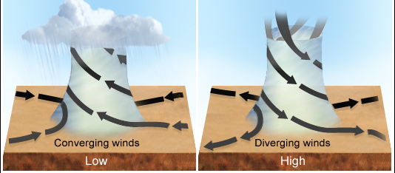
The atmosphere…
The atmosphere is constantly moving. This movement is what creates our weather!
Air moves because air flows from areas of high pressure flow towards areas of low pressure in the atmosphere.
SOURCE: https://www.abc.net.au/science/articles/2013/01/31/3679358.htm

Slide 4
Pressure systems
Low pressure systems: When air is warmed, it becomes lighter and rises. As the rising air cools, the evaporated water condenses and forms clouds. Rain can occur.
High pressure system: When air is cooled, it becomes denser and sinks towards the ground. The sinking air usually discourages cloud formation, leading to clear and stable weather.
SOURCE: https://www.abc.net.au/science/articles/2013/01/31/3679358.htm

Slide 5
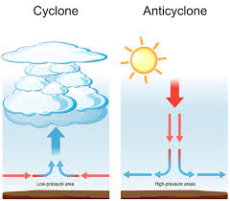
Pressure systems
Because air moves around in a cycle, we call pressure systems cyclones or anticyclones (depending on their direction).
The tropical cyclones that become hazards are essentially just extremely intense low-pressure systems
Source: Surfer Today: https://www.surfertoday.com/surfing/what-causes-a-low-pressure-system-to-form

Slide 6
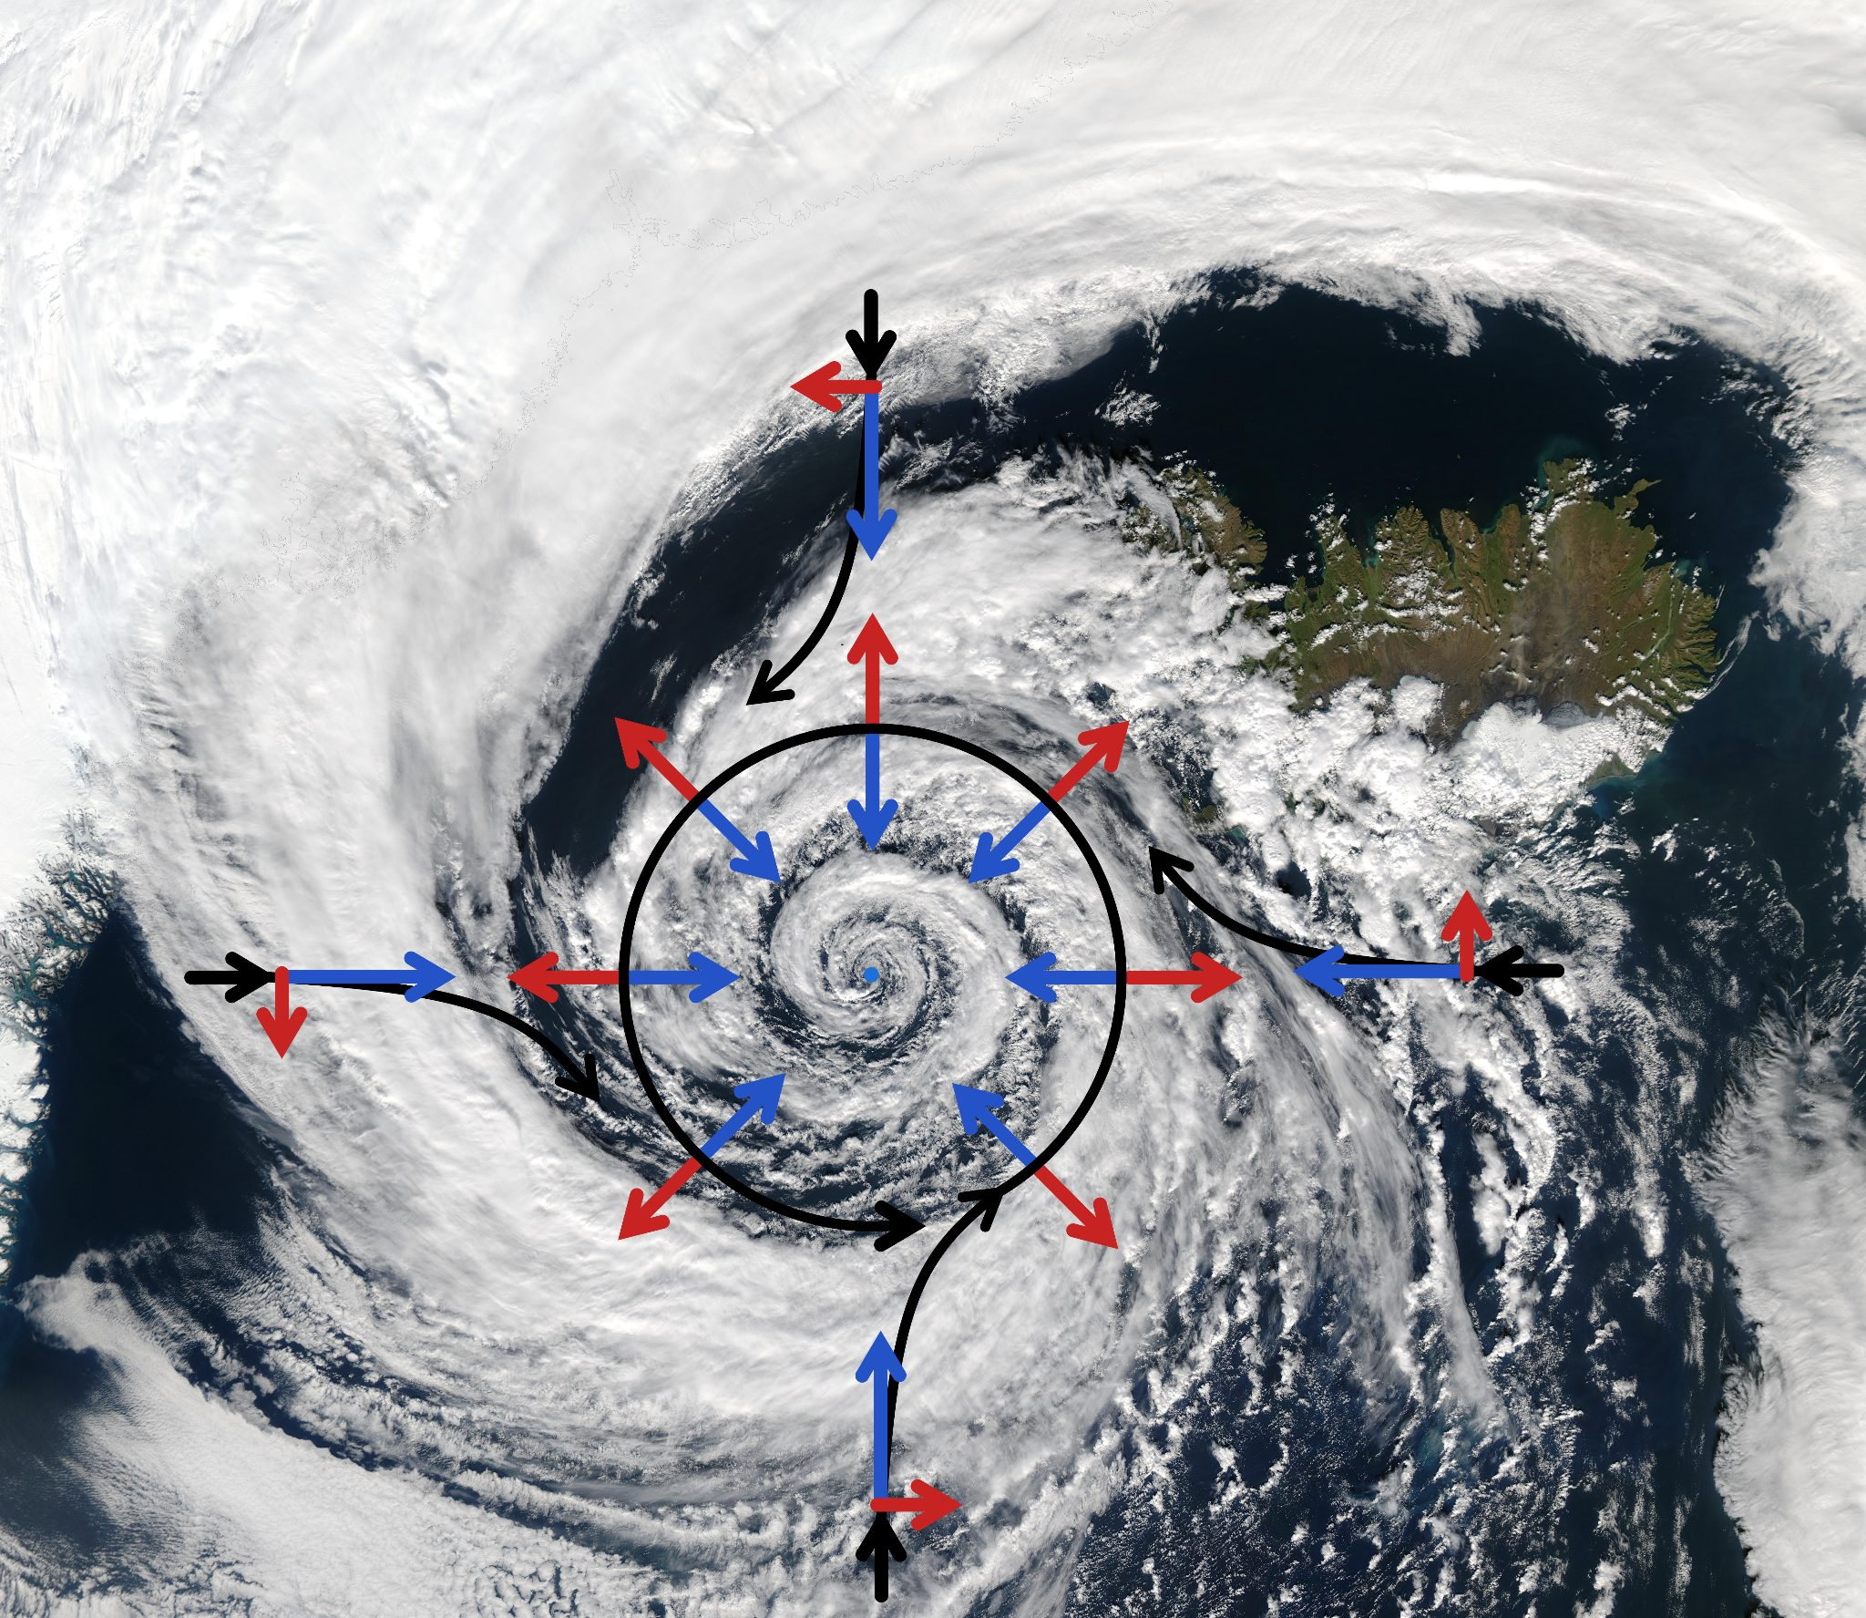
Pressure systems
This is what these pressure systems look on satellite images.
"Low-pressure-system-over-iceland-coriolis-force-overlay" by File:Low pressure system over Iceland.jpg: NASA/GSFC, MODIS Rapid Response Team, Jacques Descloitres File:Coriolis effect10.svg: Of this SVG version, Roland Geider (Ogre), of the original PNG, (Cleontuni) derivative work: MikeRun is licensed under CC BY-SA 3.0.

Slide 7
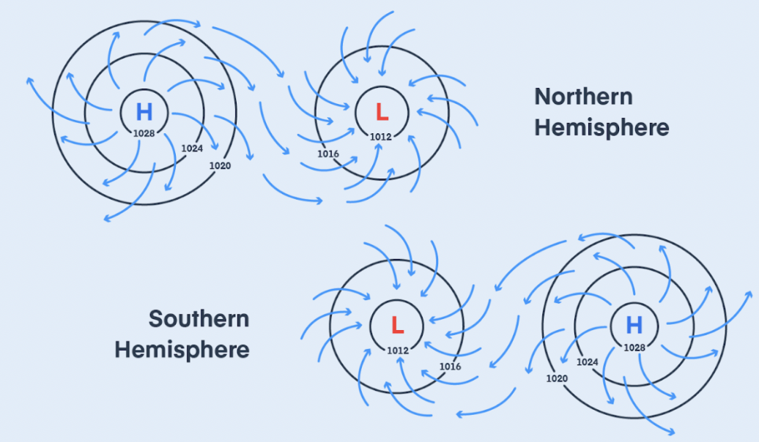
Pressure systems
High and low pressure systems rotate in different directions in the Northern and Southern Hemispheres
In the Southern Hemisphere, air moves clockwise around low-pressure systems and anticlockwise around high-pressure systems ( opposite in the Northern Hemisphere). Just image an S (the ‘high’ part turns anti-clockwise!)
S
Source: Pilot Institute- https://pilotinstitute.com/high-vs-low-pressure-systems-explained/
Notes:
Can add the cause of different directions is because of the Coriolis effect (the Earth’s rotation).

Slide 8
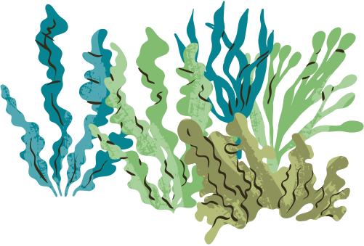
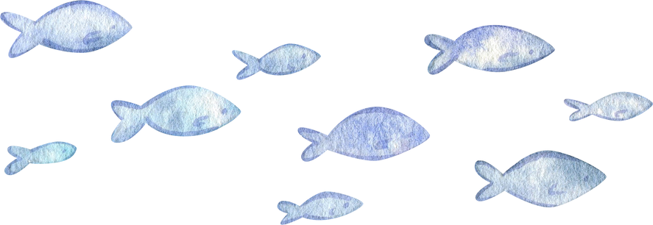
It is this information that we look for on weather maps!
Read the worksheet on synoptic charts and answer the questions.

Slide 9
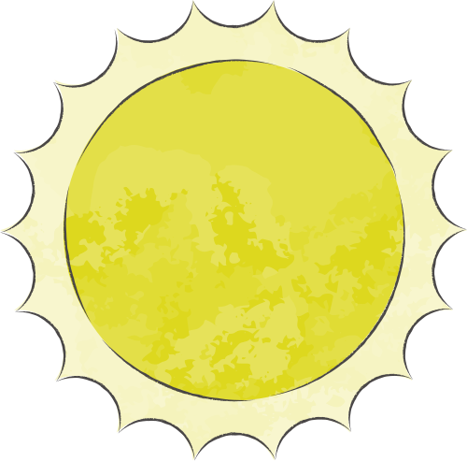
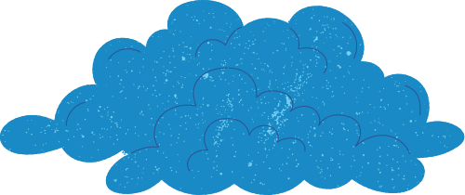
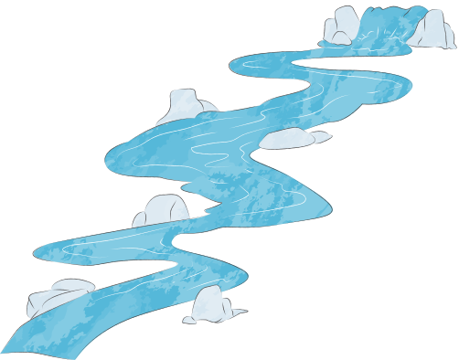
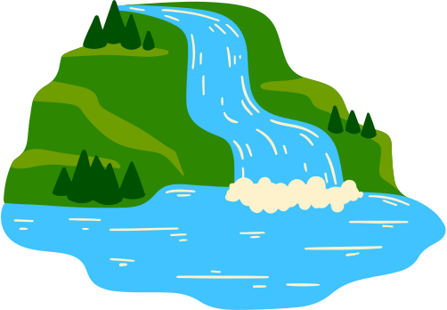
How do tropical cyclones form?
A tropical cyclone is an intense low-pressure system forming over warm tropical oceans.
They form over very warm ocean water (above 26.5°C), which provides energy through evaporation. Warm, moist air rises, creating a low-pressure system, and as this air cools and condenses, heat is released that strengthens the system.

Slide 10
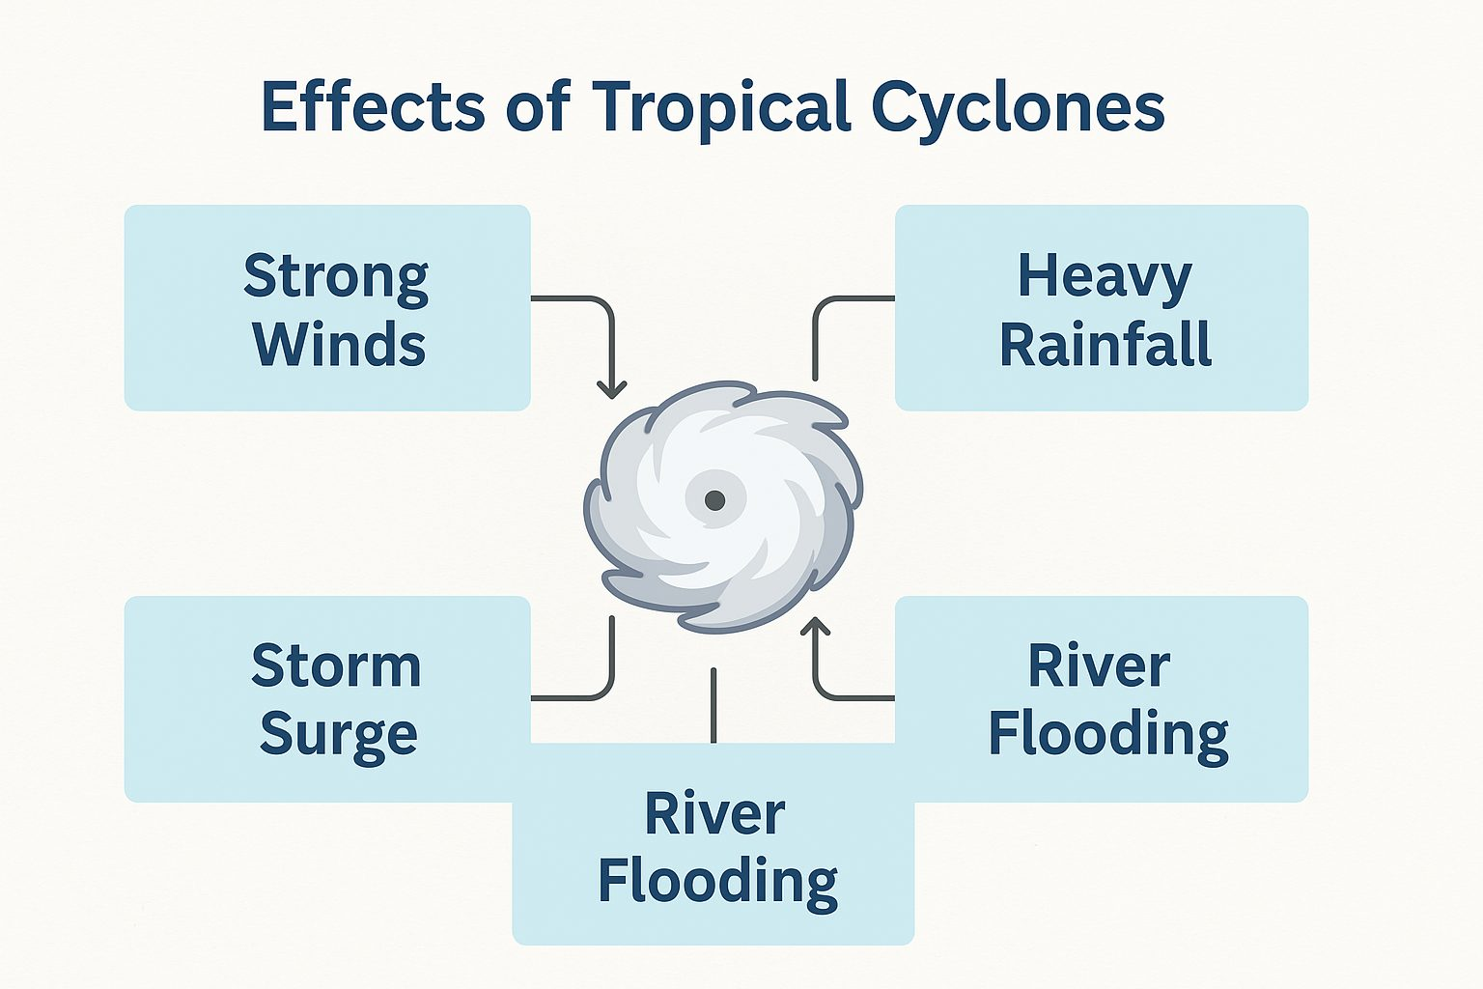
Why are tropical cyclones natural hazards?
Tropical cyclones produce very strong winds, intense rainfall, and storm surges along coastlines.

Slide 11
What are the impacts of tropical cyclones?
These effects can lead to many environmental, social and economic impacts, such as; coastal flooding, river flooding, landslides, and widespread damage to homes, infrastructure, agriculture and ecosystems, as well as long-term economic and social impacts.
ACTIVITY: Select and research ONE impact of cyclones and create an informative poster that explains its causes and effects.

